Slide 1

Double Vision and Headache
Larry Frohman, MD
Executive Vice President, NANOS
Rutgers-New Jersey Medical School

Slide 2
32-Year-Old Woman with Diplopia and Headache
Presents to neurology with two weeks of headache and double vision

Slide 3
32 Year Old Female With Diplopia and Headaches
Only past medical history was migraine with visual aura for many years
She can tell that the current headaches are different from her migraines
Headaches have a retro-ocular location

Slide 4
32 Year Old Female With Diplopia and Headaches
  The double vision is:
    Binocular (goes away when she covers either eye)
    Horizontal
    Worse at distance
    Worse when she looks to the right
Can you guess the localization based on the history she provides?

Slide 5
Examination by Neurology
Found to have isolated right abduction deficit
Rest of the examination is normal

Slide 6
Evaluation
CT of the head with contrast: normal
Plan: discharge with diagnosis of ophthalmoplegic migraine
Consult to neuro-ophthalmology just before she is to leave the ED…

Slide 7
Ophthalmoplegic Migraine
Recently renamed “Recurrent Painful Oculomotor Neuropathy” (RPON) by International Classification of Headache Disorders (ICHD)
  Incidence 0.7/million
  Headache followed by ipsilateral 3,4, or 6th nerve palsy
    Double vision immediate or up to two weeks later
    Can last weeks to months
  Oculomotor palsies in ophthalmoplegic migraine may show thickening and enhancement of third nerve on MRI

Slide 8
Why Was This Case Not Likely
Recurrent Painful Oculomotor Neuropathy (RPON)?
RPON is less common with a sixth nerve palsy
Onset of at age 32 would be highly unusual!
Is any more work up needed?
What would you do?
Notes:
This slide should be changed to use the newer / more accurate term – RPON - OK

Slide 9
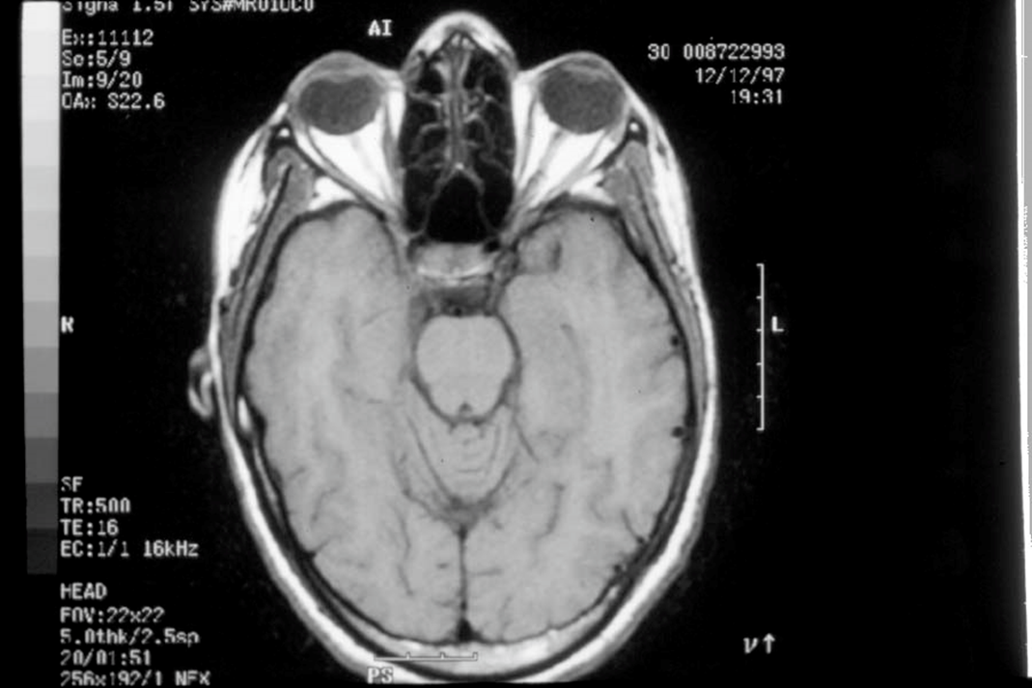
MRI Is Required in Workup of
RPON
What abnormality do you see?
Notes:
Again, change to OM to RPONok)

Slide 10
MRI Without Contrast Done Overnight
Read as normal
Is set to be discharged with diagnosis of RPON
Is this a reasonable plan?
Notes:
Again, change to OM to RPON

Slide 11
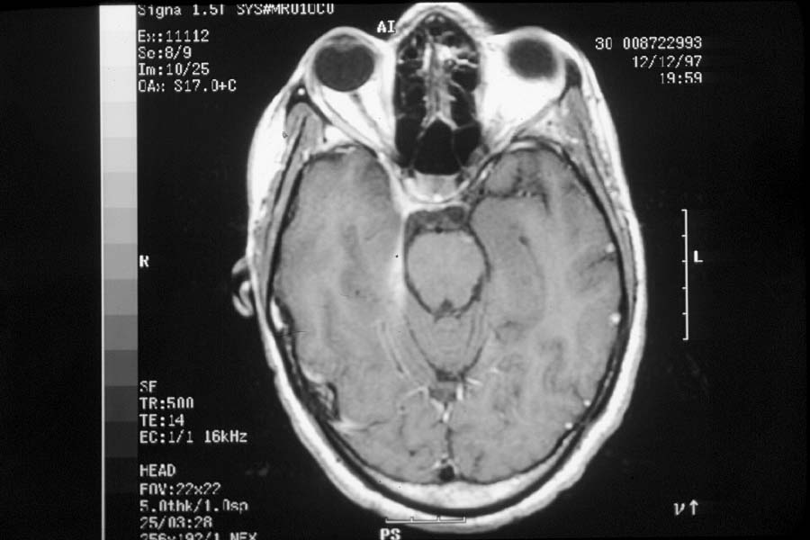
MRI with Contrast Requested by Neuro-Ophthalmology
What abnormality do you see now?

Slide 12
MRI with Contrast
Dural enhancement,
or “Dural Tail”, not easily seen without contrast, is seen on the side of the sixth nerve palsy (pink arrows). The cavernous sinus also enhanced (yellow arrowhead)
Note this is not present on other side- Look for the asymmetry!
Notes:
Right Cavernous sinus is also abnormal- OK

Slide 13
Differential Diagnosis of a Dural Tail¹
Meningioma -most common
Lymphoma
Chloroma
Cerebral metastasis
Glioblastoma
Multiple myeloma
Aspergillosis
Chordoma
Schwannoma
Pleomorphic xanthoastrocytoma
Hemangiopericytoma
Wegener’s granulomatosis (Granulomatosis with polyangiitis)
Sarcoidosis
Medulloblastoma
Eosinophillic granuloma
Erdheim Chester Disease

Slide 14
32 Year Old Woman With Diplopia and Headache
What is your workup after you see the MRI findings?

Slide 15
Results
  CXR: negative
  Angiotensin Converting Enzyme (ACE): Negative
  Lumbar Puncture
    Normal cell counts and protein
  PPD positive (but recalls she had undergone BCG vaccination)
  Anergy Panel- demonstrated anergy
  24 hour urine calcium normal

Slide 16
What Else Might be Helpful and Less Invasive than a Biopsy of Meningeal Lesion?
Gallium or PET-CT Scan

Slide 17
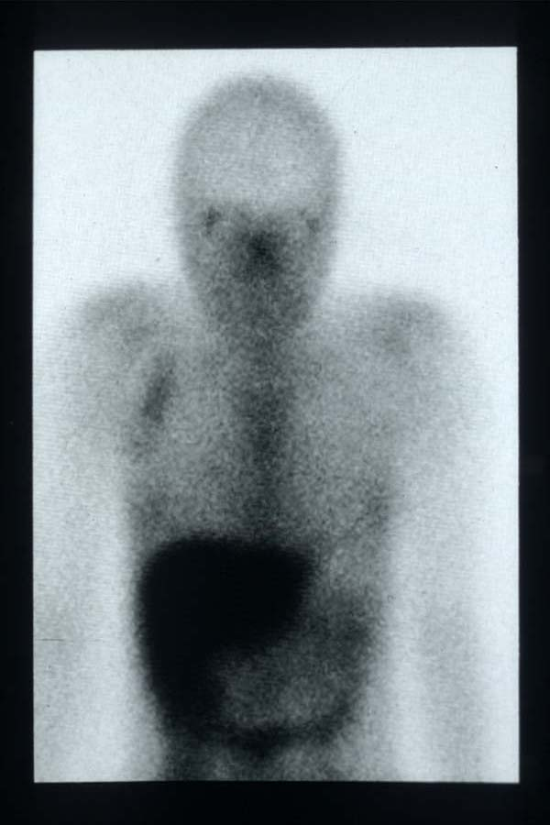
Gallium Scan Performed
Sole abnormality in whole body gallium scan is this right axillary lymph node.

Slide 18
Clinical Course
Patient was unaware of lymph node
It was biopsied
Pathology – consistent with sarcoidosis
She had no other involvement, including no evidence of ocular sarcoidosis

Slide 19
Treatment
  Placed on prednisone, one mg/kg/day
  Alleviated pain within hours
  Diplopia resolves in days

Slide 20
Gallium and PET-CT Scans in Sarcoid Workup
Allow for Application of Sutton’s Law
Who was Sutton?

Slide 21
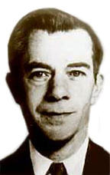
Willie Sutton- Bank Robber-
Asked “Why Do You Rob Banks?”
“Because that is where the money is!”

Slide 22
Application of Sutton’s Law
“GO WHERE THE MONEY IS”
Use the gallium or PET scan to guide your needle/knife
Biopsy the most accessible tissue that “lights up”
  Bronchscopy
  Lacrimals
  Parotids
  Salivaries
  Liver...

Slide 23
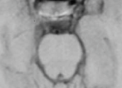

Neuro-Ophthalmology Has Been Defined As a Field Where One Reinterprets Previously Normal Images
Look carefully at the area within the pink on the left side of this magnified view of the prepontine cisternal spaces on the non-contrast MRI.
There is a space-occupying lesion present in the right prepontine cisternal space that is not seen on the other side. Because we knew where we suspected a lesion would be, we insisted on getting a contrasted MRI.
The history and exam guides your imaging and informs the radiologist where the lesion might be.
Notes:
Pink circles are not centered on Cavernous sinuses; cavernous sinuses are lateral border of sella. The pink circles are centered on pre-pontine cisternal spaces OK

Slide 24
Utility of 18F-FDG PET/CT
In the subsequent images (next slide) the question in this next patient was whether the lesion was a meningioma or not.
The avidity for FDG (yellow areas) would not be seen in meningioma. This led to a suspicion of sarcoidosis. Rather than biopsy the meninges, an inguinal node also showed avidity for FDG and was biopsied, and demonstrated sarcoid

Slide 25
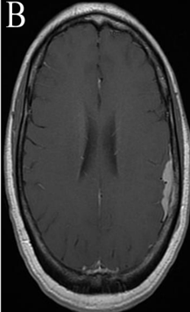
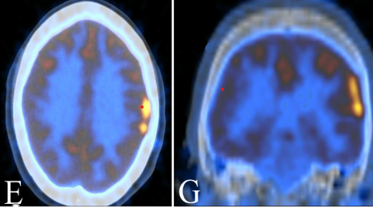
PET-CT for Neurosarcoid
B is post-Gadolinium T1 weighted axial MRI.
E and G are axial and coronal 18F-FDG PET/CT²
²Khodarahmi I, Ghesani N, Turbin RE, Frohman LP. ¹⁸F-fluorodeoxyglucose Uptake in Neurosarcoid Dural Plaque on PET/CT. Clinical Nuclear Medicine. 41(9):e410-1, 2016 Sep

Slide 26
Summary: In a patient where neurosarcoid is being considered, a standard set of examinations is helpful to establish the diagnosis
These include blood work for
  Calcium
  ACE
  Lysozyme
  Quantiferon gold
  Liver functions
Other helpful tests
  Anergy panel
  24 hour urine calcium
  Lumbar puncture- may include CSF ACE
  Pulmonary Function Testing
  EKG
Notes:
Should this slide discuss sensitivity and specificity of these tests: the actual utility of calcium, ACE, lysozyme, & LFTs for diagnosis of neurosarcoid are extremely low and would be in violation of suttons law. CSF ACE & urine calcium is similarly low utility.
I agree EKG is a reasonable test because cardiac sarcoid is potentially life threatening and poorly evaluated on CXR or CT chest
I do not think that given the purpose and target audience of the case, we need to do that (give % of abnormalities) . If someone is really interested, the references would address this

Slide 27
Summary-2
Useful imaging studies include
  Chest X-ray
  Chest CT
  Gallium Scan
  PET–CT Scan
A tissue diagnosis is best; the imaging studies will help determine the best candidate site for biopsy

Slide 28
Additional References
Frohman LP. Treatment of neuro-ophthalmic sarcoidosis. J Neuroophthalmol. 2015;35(1):65-72. doi:10.1097/WNO.0000000000000170, 10.1097/WNO.0000000000000170
Frohman LP, Grigorian R, Bielory L. Neuro-ophthalmic manifestations of sarcoidosis: clinical spectrum, evaluation, and management. J Neuroophthalmol. 2001;21(2):132-7. doi:10.1097/00041327-200106000-00016
Frohman LP, Guirgis M, Turbin RE, Bielory L. Sarcoidosis of the anterior visual pathway: 24 new cases. J Neuroophthalmol. 2003;23(3):190-7. doi:10.1097/00041327-200309000-00002
Kefella H, Luther D, Hainline C. Ophthalmic and neuro-ophthalmic manifestations of sarcoidosis. Curr Opin Ophthalmol. 2017;28(6):587-594. doi:10.1097/ICU.0000000000000415, 10.1097/ICU.0000000000000415
Koczman JJ, Rouleau J, Gaunt M, Kardon RH, Wall M, Lee AG. Neuro-ophthalmic sarcoidosis: the University of Iowa experience. SEMIN. OPHTHALMOL.. 2008;23(3):157-68. doi:10.1080/08820530802007382, 10.1080/08820530802007382
Pawate S, Moses H, Sriram S. Presentations and outcomes of neurosarcoidosis: a study of 54 cases. QJM. 2009;102(7):449-60. doi:10.1093/qjmed/hcp042, 10.1093/qjmed/hcp042
Phillips YL, Eggenberger ER. Neuro-ophthalmic sarcoidosis. Curr Opin Ophthalmol. 2010;21(6):423-9. doi:10.1097/ICU.0b013e32833eae4d, 10.1097/ICU.0b013e32833eae4d
Tannen BL, Ghesani NV, Frohman L, Eichler JD, Maldjian PD, Chu DS. Use of whole-body FDG PET-CT to aid in the diagnosis of occult sarcoidosis. Ocul Immunol Inflamm. 2008;16(1):25-7. doi:10.1080/09273940801899798, 10.1080/09273940801899798
Tannen BL, Kolomeyer AM, Turbin RE, et al. Lacrimal gland uptake of (67)Ga-gallium citrate correlates with biopsy results in patients with suspected sarcoidosis. Ocul Immunol Inflamm. 2014;22(1):15-22. doi:10.3109/09273948.2013.791700, 10.3109/09273948.2013.791700

